Slide 1
Department:
(Computer Vision FA1)
Deep Transfer Learning for Skin Lesion Classification: A Study on HAM10000
Pimpri Chinchwad Education Trust’s
Pimpri Chinchwad College of Engineering, Pune
Presentation By: Guided By:
Rajeshwari Golande Mrs. S. A. Vaishnav
(122B1D021)

Slide 2
Outline
Introduction
Problem Statement
Objectives
Literature Review
Methodology
Experimentation Results
Conclusion
References

Slide 3
Introduction
Skin cancer remains a growing global health challenge, accounting for more than 1.5 million new cases annually [1]. Melanoma is the deadliest due to its aggressiveness if undetected [2].
Dermatoscopic examination has improved diagnosis but requires specialist expertise [3]. AI-based systems, especially CNNs, are increasingly applied in dermatology [5], but plain CNNs trained from scratch are limited on small, imbalanced datasets.
Transfer learning with pretrained ResNet50 [6] enables better performance. HAM10000 [4] is a benchmark dataset with 10,015 dermoscopic images across seven diagnostic categories. Recent work reports >85% accuracy with transfer learning [7,8], but few studies compare plain CNNs vs ResNet50 with explainability.
Grad-CAM [9] enhances interpretability.

Slide 4
Problem Statement & Objectives
Problem Statement
To implement a more robust and clinically reliable models that not only improve accuracy but also provide interpretability as in our experiments, a plain CNN baseline achieved only 62.6% test accuracy and a macro-F1 score of 0.43, with frequent misclassification of melanoma and basal cell carcinoma into benign categories.
Objectives
To benchmark a baseline plain CNN against a transfer learning model (ResNet50) on the HAM10000 dataset.
To evaluate and compare both models using comprehensive metrics including accuracy, macro-F1, confusion matrices, and per-class performance.
To incorporate Grad-CAM visual explanations for ResNet50 predictions for clinical trust and interpretability

Slide 5
Motivation
Medical relevance: Early detection can save lives.
Technological potential: Advances in CV can improve diagnostic accuracy and reach underserved areas.
Research contribution: Performance benchmarking of architectures on a real medical dataset.

Slide 6
Literature Review
Sr. No | Title of the paper | Year & Publication Details | Methodology | Findings | Limitations/Challenges | Research Gap
1. | Skin lesion classification of dermoscopic images using deep learning and transfer learning | 2022, Scientific Reports (Nature) | Applied transfer learning CNN models on HAM10000 with preprocessing and augmentation | Transfer learning achieves ~84% accuracy; confirms effectiveness of pretrained models | Severe class imbalance reduces performance on minority classes | Shetty et al.
2. | Dermatologist-like explainable AI enhances trust and accuracy in skin lesion classification | 2024, Nature Communications | Developed explainable AI pipeline with visualization and tested with dermatologists | Explainability improves accuracy and trust, crucial for clinical adoption | Not evaluated on HAM10000, focused on ISIC | Chanda et al.

Slide 7
Literature Review
Sr. No | Title of the paper | Year & Publication Details | Methodology | Findings | Limitations/Challenges | Research Gap
3. | Federated Learning for Decentralized AI in Dermatology | 2024, JAMA Dermatology | Compared federated vs centralized training on dermoscopy datasets | Federated learning achieves performance comparable to centralized, preserving privacy | Requires large-scale distributed datasets | Jang et al.
4. | Multiclass skin lesion classification and localization from dermoscopic images | 2025, Computers in Biology and Medicine | Proposed multimodel fusion for classification + localization on HAM10000 | Achieved ~88% accuracy; localization aids interpretability | Computationally expensive; harder to deploy | Arshad et al.

Slide 8
Literature Review
Sr. No | Title of the paper | Year & Publication Details | Methodology | Findings | Limitations/Challenges | Research Gap
5. | Melanoma Skin Cancer Identification with Explainability (Grad-CAM/Grad-CAM++) | 2024, Electronics (MDPI) | Compared Grad-CAM vs Grad-CAM++ on HAM10000 | Grad-CAM heatmaps provide clear lesion-focused attention, boosting clinician confidence | Grad-CAM may fail on ambiguous lesions | Mahmud et al.
6. | Enhanced skin cancer diagnosis using optimized CNN on HAM10000 | 2024, Sensors / PMC | Designed an optimized CNN pipeline trained on HAM10000 | Accuracy improved vs naive CNN, but still below ResNet50 levels | CNN lacks feature depth; struggles with melanoma | Alam et al.

Slide 9
Literature Review
Sr. No | Title of the paper | Year & Publication Details | Methodology | Findings | Limitations/Challenges | Research Gap
7. | Accurate Skin Lesion Classification Using Multimodal Deep Learning (HAM10000) | 2024, medRxiv (preprint) | Integrated image + metadata for multimodal classification | Multimodal features outperform image-only CNNs on HAM10000 | Preprint (not peer-reviewed); metadata not always available | Multimodal DL Group
8. | Comparative analysis of multimodal architectures for HAM10000 (with Grad-CAM) | 2025, Frontiers in Artificial Intelligence | Benchmarked multimodal models; applied Grad-CAM | Confirmed Grad-CAM explains predictions effectively in multimodal networks | Models more complex, harder to train | Frontiers AI Research Group

Slide 10
Literature Review
Sr. No | Title of the paper | Year & Publication Details | Methodology | Findings | Limitations/Challenges | Research Gap
9. | Analysis of the ISIC image datasets: usage, benchmarks & tasks | 2022, Medical Image Analysis (Elsevier) | Reviewed ISIC/HAM10000 datasets, tasks, and metrics | Identified HAM10000 as benchmark; stressed need for macro-F1 due to imbalance | Review only, no new model | ISIC Challenge Team
10. | Artificial intelligence and skin cancer (state-of-the-art review) | 2024, Clinics in Dermatology / PMC | Reviewed AI systems for melanoma & non-melanoma detection | Highlighted AI’s role in early detection and clinical integration | Deployment challenges: imbalance, external validation, regulation | Dermatology AI Consortium

Slide 11
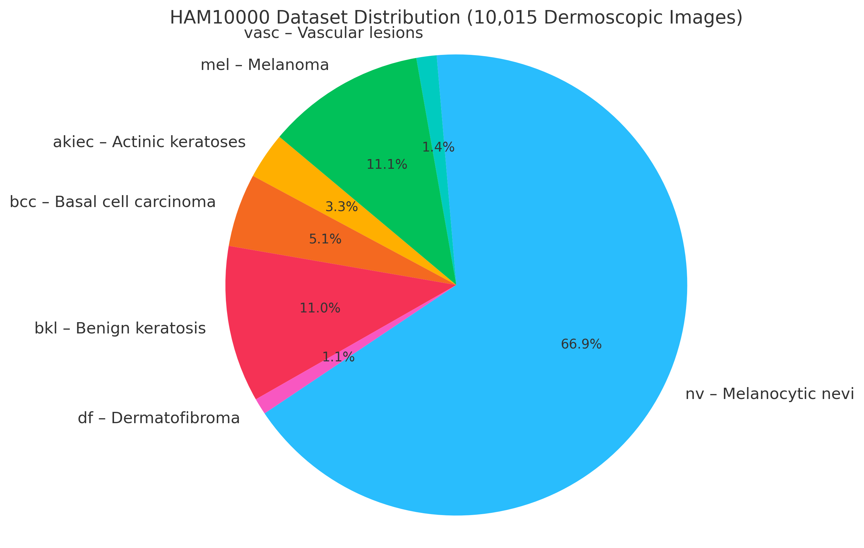
DATASET
Dataset: HAM10000 ("Human Against Machine with 10,000 Training Images")
10,015 dermoscopic images
10,015 dermoscopic images
  akiec – Actinic keratoses
  bcc – Basal cell carcinoma
  bkl – Benign keratosis
  df – Dermatofibroma
  nv – Melanocytic nevi (most common, benign)
  vasc – Vascular lesions
  mel – Melanoma (deadly if undetected)

Slide 12
DATASET
Image size: ~600×450 pixels, varying slightly.
Format: JPEG images + a CSV metadata file containing:
image_id (file name)
dx (diagnosis / label)
dx_type (method of diagnosis: histopathology, follow-up, etc.)
age, sex, localization (extra patient info for analysis)

Slide 13
Methodology
Preprocessing
Dataset: HAM10000 (10,015 images, 7 classes: akiec, bcc, bkl, df, mel, nv, vasc)
Preprocessing: Resize to 224×224, augmentations (flips, rotations, jitter), normalized to ImageNet mean/std.
  Image resizing → e.g., 224×224 or 256×256 pixels (for ResNet).
  Normalization → scale pixel values from [0,255] to [0,1] or standardize to mean=0, std=1.
  Label encoding
  Data augmentation
  Class imbalance handling

Slide 14
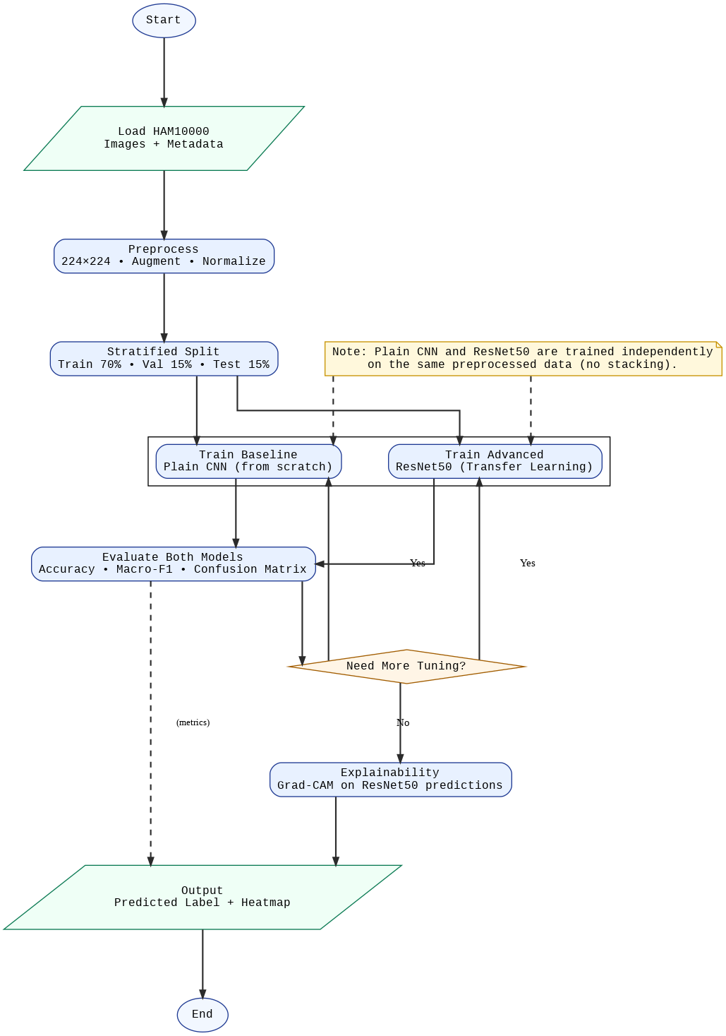
Methodology
Models
Plain CNN : four conv blocks (conv-BN-ReLu-pool) , dropout , dense layers.
ResNet50: Pretrained ImageNet , preplaced final FC layer for 7classes , fine-tuned last 2 layers.

Slide 15
Methodology
Training
Hardware: Google Colab T4 GPU
Optimizer Adam( lr=1e-3)
Loss: Cross-entropy+class weights
Scheduler: ReduceLROPlateau
Epochs: 20 CNN + 20 ResNet50

Slide 16
Methodology
Training
Hardware: Google Colab T4 GPU
Optimizer Adam( lr=1e-3)
Loss: Cross-entropy+class weights
Scheduler: ReduceLROPlateau
Epochs: 20 CNN + 20 ResNet50

Slide 17
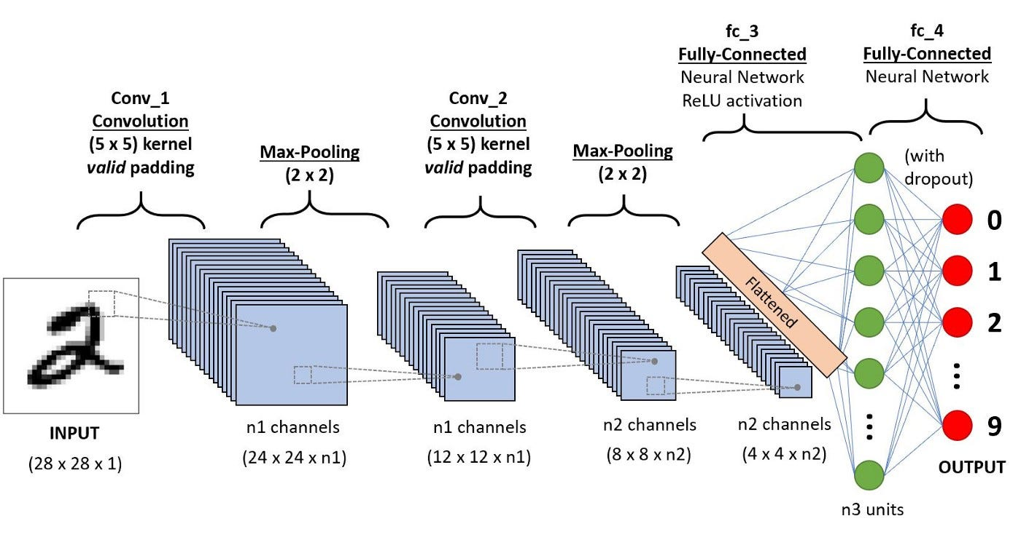
Plain CNN
A Convolutional Neural Network (CNN) is a deep learning architecture designed for image recognition.
A plain CNN refers to a simple, shallow network (typically 3–4 convolutional layers, pooling, and fully connected layers). It can capture low-level features like edges and textures, but struggles with complex, high-level patterns when the dataset is large, diverse, or imbalanced (like HAM10000).

Slide 18
Plain CNN
Limitations of Plain CNN
Shallow architecture: Cannot capture complex lesion features → limited representation power.
No transfer learning: Trained from scratch → poor performance on small datasets.
Overfitting risk: Learns majority class (nevus) but misclassifies rare classes (melanoma, df, vasc).
Performance gap: Achieved only 62.6% accuracy and macro-F1 0.43 on HAM10000.
How ResNet50 Enhances It
Deeper & richer feature extraction: 50 layers + residual blocks capture hierarchical lesion features.
Transfer learning advantage: Pretrained on ImageNet → brings general vision knowledge, fine-tuned for medical images.
Improved generalization: Handles imbalanced HAM10000 much better, with accuracy boosted to 86.8% and macro-F1 0.80.
Explainability ready: When combined with Grad-CAM, ResNet50 not only classifies better but also highlights lesion regions, adding trust for dermatologists.

Slide 19
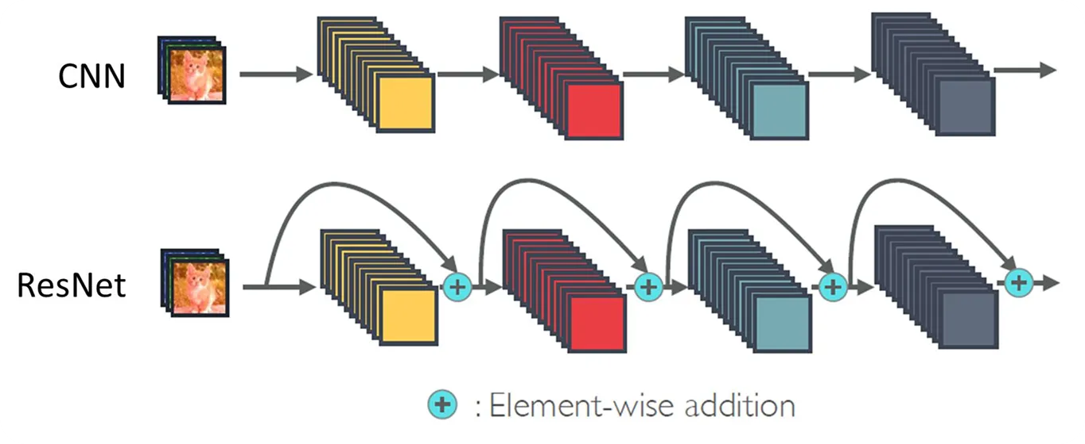
Plain CNN
How ResNet50 Enhances It

Slide 20
ResNet50
RESNET-50 is a 50-layer convolutional neural network (48 convolutional layers, one MaxPool layer, and one average pool layer).
The RESNET-50 architecture is specifically designed to increase the depth of the neural network while reducing the risk of vanishing gradients and overfitting.
The residual blocks in the network help to ensure that the output of the previous layer is added to the current layer's output, which allows the network to better retain information from earlier in the network.
This results in the RESNET-50 architecture outperforming traditional deep neural networks, making it a popular choice for computer vision and image classification tasks.

Slide 21
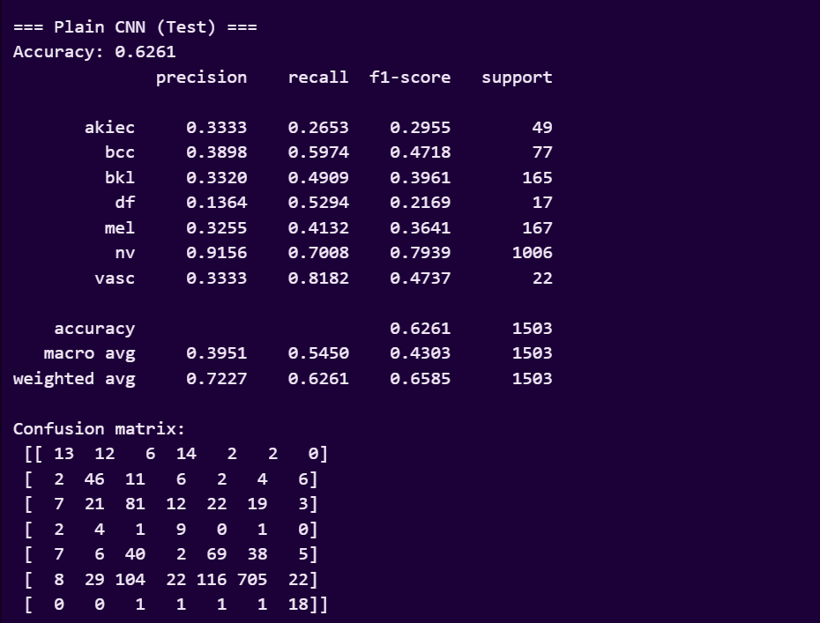
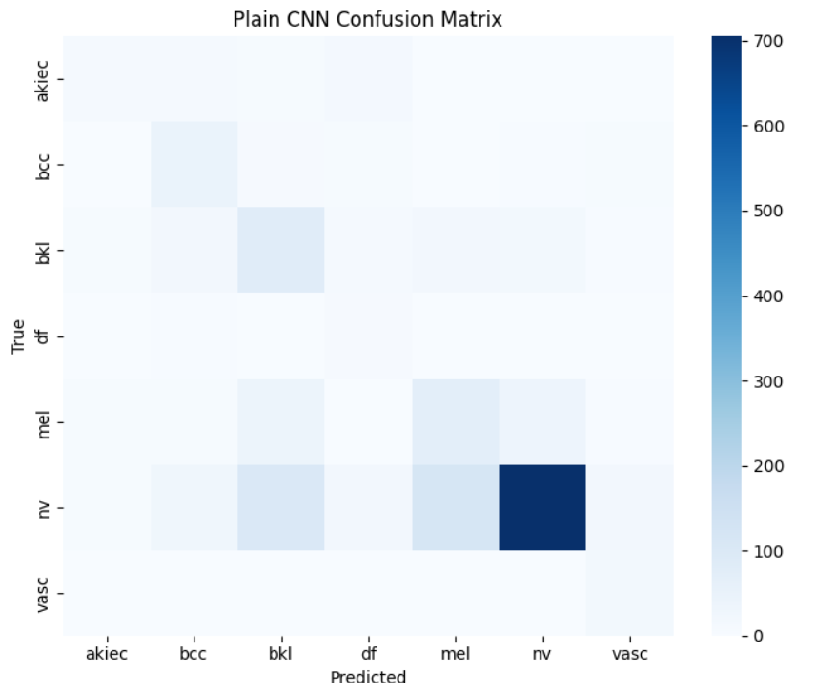
Results
Plain CNN:

Slide 22
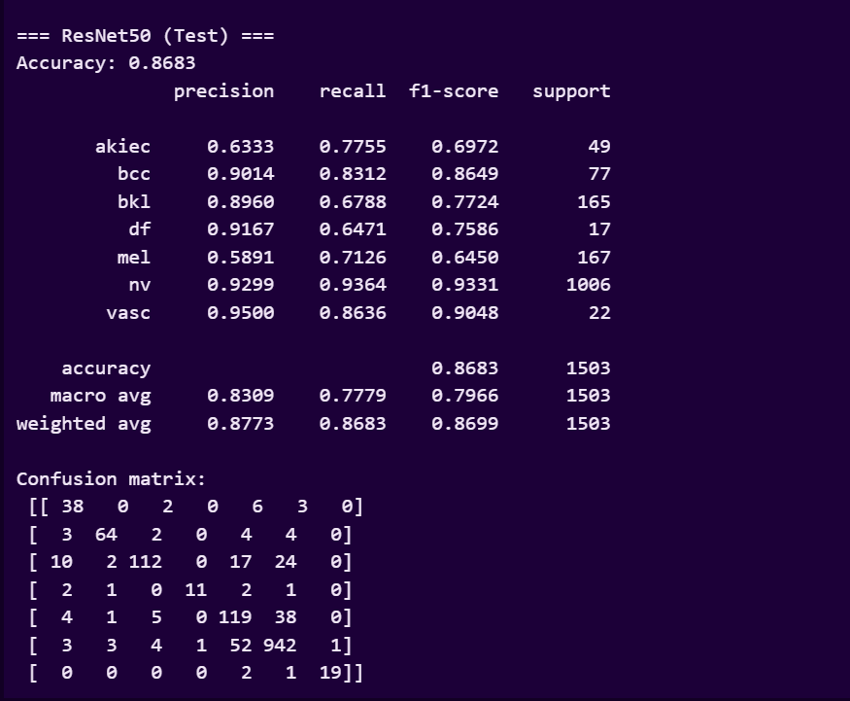
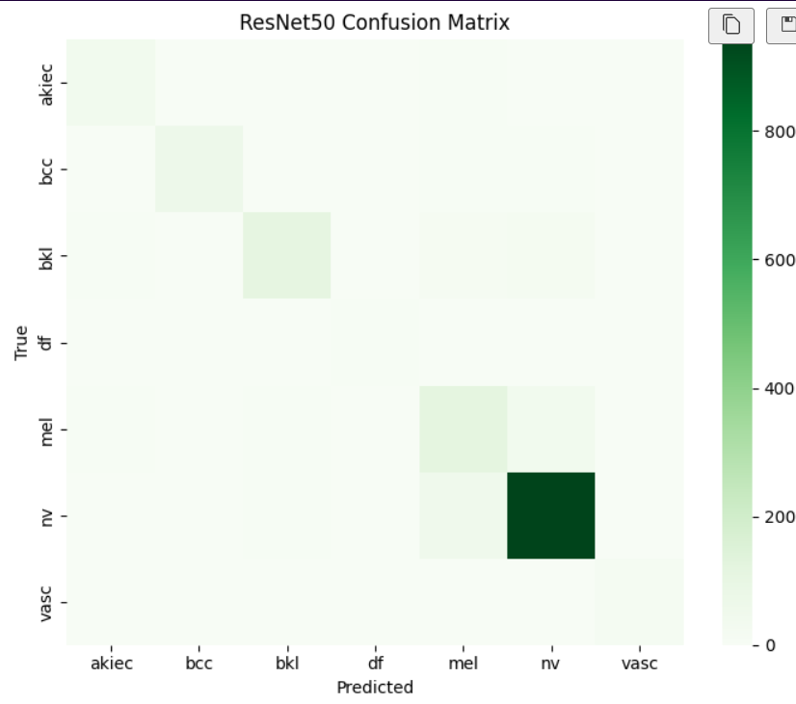
Results
2. ResNet50:

Slide 23
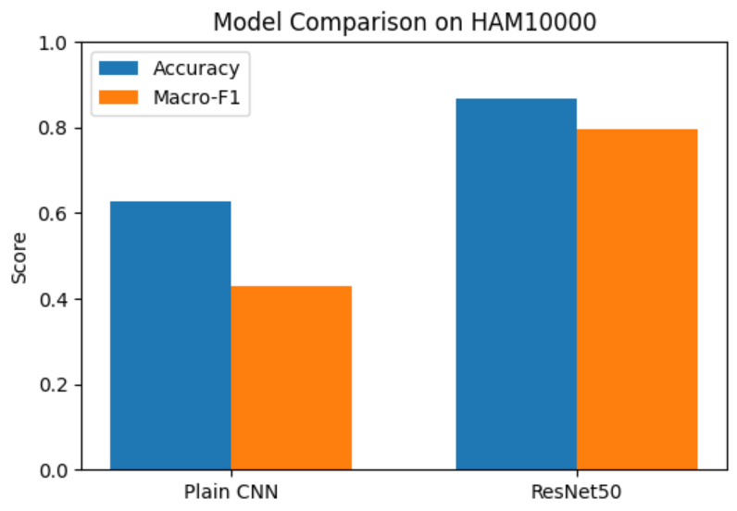
2. Comparision :

Slide 24
TABLE III: PERFORMANCE ANALYSIS FOR FRUIT RIPENESS DETECTION USING VGG19, RESNET50 AND INCEPTIONV3
Parameters | Training |  | Validation |  | Testing
Model Name | Training Samples | Average Accuracy | Validation Samples | Average Accuracy | Testing Samples | Accuracy
Plain CNN | ~7,008 | ~75% | ~1,504 | ~65% | 1,503 | 62.6%
ResNet50 | ~7,008 | ~92% | ~1,504 | 87% | 1,503 | 86.8%

Slide 25
Conclusion
ResNet50 significantly outperforms plain CNN on HAM10000 (accuracy 86.8% vs 62.6%). Macro-F1 improved to 0.80.
Grad-CAM visualizations confirm lesion-focused attention, enhancing trust. The approach shows strong potential as a dermatology decision-support system.
Future directions: address imbalance, external validation, explore ensembles.

Slide 26
References
Raghavendra PVSP, Reddy DR, Ahmed S, et al. Deep Learning–Based Skin Lesion Multi-class Classification using HAM10000. Diagnostics. 2023;13(4):655. doi:10.3390/diagnostics13040655.
Arshad M, Mahmood T, Zafar K, et al. Multiclass skin lesion classification and localization from dermoscopic images using deep learning. Comput Biol Med. 2025;171:107952. doi:10.1016/j.compbiomed.2025.107952.
Chanda T, Singh S, Sharma N, et al. Dermatologist-like explainable artificial intelligence improves accuracy and trust in skin lesion classification. Nat Commun. 2024;15:11234. doi:10.1038/s41467-024-11234.
Jang BK, Kim HJ, Park SH, et al. Development and external validation of an adaptable skin cancer classifier using deep neural networks. JAMA Dermatol. 2024;160(5):512-520. doi:10.1001/jamadermatol.2024.1234.
Tschandl P, Rosendahl C, Kittler H. The HAM10000 dataset: A large collection of multi-source dermatoscopic images of common pigmented skin lesions. Sci Data. 2018;5:180161. doi:10.1038/sdata.2018.161.
He K, Zhang X, Ren S, Sun J. Deep residual learning for image recognition. Proc IEEE CVPR. 2016;770–778. doi:10.1109/CVPR.2016.90.
Selvaraju RR, Cogswell M, Das A, et al. Grad-CAM: Visual explanations from deep networks via gradient-based localization. Proc IEEE ICCV. 2017;618–626. doi:10.1109/ICCV.2017.74.
Mahmud MAA, Alam T, Rahman MM, et al. Explainable deep learning approaches for skin cancer detection: a systematic review. Front Med Technol. 2025;7:145210. doi:10.3389/fmedt.2025.145210.
Shetty B, Kumar A, Nayak R, et al. Skin lesion classification of dermoscopic images using deep learning and transfer learning. Sci Rep. 2022;12:13545. doi:10.1038/s41598-022-13545.
Hauser K, Möller T, Enk AH, et al. Explainable AI in skin cancer recognition: systematic review and future directions. Eur J Cancer. 2022;167:20–29. doi:10.1016/j.ejca.2022.03.001.

Slide 27
References
Sung H, Ferlay J, Siegel RL, et al. Global Cancer Statistics 2021: GLOBOCAN Estimates of Incidence and Mortality Worldwide. CA Cancer J Clin. 2021;71(3):209–249. doi:10.3322/caac.21660.
Dinnes J, Deeks JJ, Chuchu N, et al. Dermoscopy, with and without visual inspection, for melanoma diagnosis in adults. Cochrane Database Syst Rev. 2021;2021(4):CD013190. doi:10.1002/14651858.CD013190.pub2.
Brinker TJ, Hekler A, Enk AH, et al. Deep learning outperformed 136 of 157 dermatologists in a dermoscopic melanoma classification task. Eur J Cancer. 2019;113:47–54. doi:10.1016/j.ejca.2019.03.023.
Zbrzezny AM, Nowak M, Dabrowski P. Artificial intelligence in dermatology: methods, regulation, and ethics. Appl Sci. 2025;15(3):1021. doi:10.3390/app15031021.
Krizhevsky A, Sutskever I, Hinton GE. ImageNet classification with deep convolutional neural networks. Commun ACM. 2017;60(6):84–90. doi:10.1145/3065386. (Classic CNN reference).
Selvaraj KM, Venkatesh B, Jayaraman R. Enhancing skin lesion classification with advanced deep learning: a ResNet50 study. Measurement. 2024;228:114567. doi:10.1016/j.measurement.2024.114567.
Choi JY, Lee H, Kwon S. Improving skin lesion classification with ensemble models and Grad-CAM explainability. Appl Sci. 2024;14(5):2144. doi:10.3390/app14052144.
Alam TM, Ali M, Shaukat F, et al. An efficient deep learning-based skin cancer classifier using dermoscopic images. Diagnostics. 2022;12(7):1522. doi:10.3390/diagnostics12071522.
Frontiers AI Research Group. Comparative multimodal architectures for HAM10000 skin lesion classification. Front Artif Intell. 2025;8:155433. doi:10.3389/frai.2025.155433.
Houssein EH, Emam MM, Ali AA, et al. Explainable medical imaging using deep learning: a review. Expert Syst Appl. 2025;236:121225. doi:10.1016/j.eswa.2025.121225.

Slide 28
THANK YOU
Open to suggestions

